Slide 1


Learning about Git and GitHub.

Slide 2
What exactly GIT is ?
GIT is an Open-Source distributed version control system.
It is a tool which is used for source code management.
Git distinguishes from other version-controlled system and has GIT branches which are easy to work with.
These branches provide an isolated environment for every change to your codebase.

Slide 3
GIT Installation:

Slide 4
GIT can operate using both the GUI app and the Command Line, but command line offers us more flexibility and accessibility to access the functions. GIT works on UNIX based system hence it commands are similar to that of UNIX/Linux/MacOS. For windows git provide a “Git Bash” where you can write these commands.
“git config --global user.name <username>” – This command is used configure the username in your git, so that all the commits and clones are made by using your username.
“git config --global user.email <email>” – This command is almost like the previous command, its just that it is used to configure the email of your git account, so that whenever you make any change in any repo, your email reflects there.
“git config --global user.name” and “git config --global user.email” – These commands are used to view and check whether your username and email has been entered correctly or not.

Slide 5
Concept of Staging in Git:

Slide 6
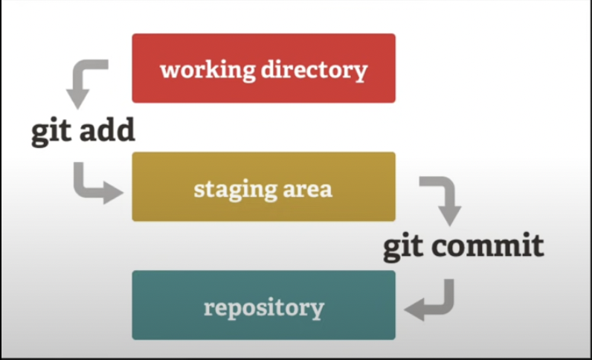
“git init” – This command is used to initialize a local git repository inside a folder on your system.
“git status” – This command is used to check whether a file in your local repository folder is being tracked by the GIT or not.
“git add <filename>” – This command is used to tell the GIT, that it needs to track that file and hence this file gets stagged and now is been monitored by GIT.
“git add .” – This command is used to stage all the files in the folder in order to be tracked by GIT.
“git commit –m “Your Message” ”: This command is used to make a commit in your local git repository.

Slide 7
What exactly a commit is?
The git commit command captures a snapshot of the project's currently staged changes.
Committed snapshots can be thought of as “safe” versions of a project—Git will never change them unless you explicitly ask it to.
Using this commit feature one can restore the changes the made to file and get the previous versions of their files.

Slide 8
Branches in GitHub

